Slide 1
Bookmarked
Product Backlog & Sprint Planning
Product Manager: Ian Hunter Team members: Justin Passanisi, Jesus Arechiga, John Jack Dubil, Prem Panchal, Yoho Chen, Marie Holen, Paul Diaz

Slide 2
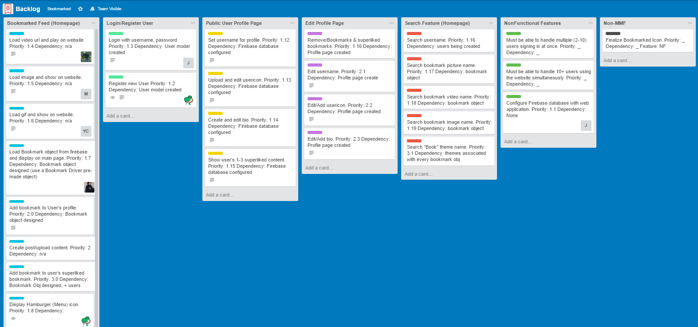
Product Backlog - Trello Overview

Slide 3
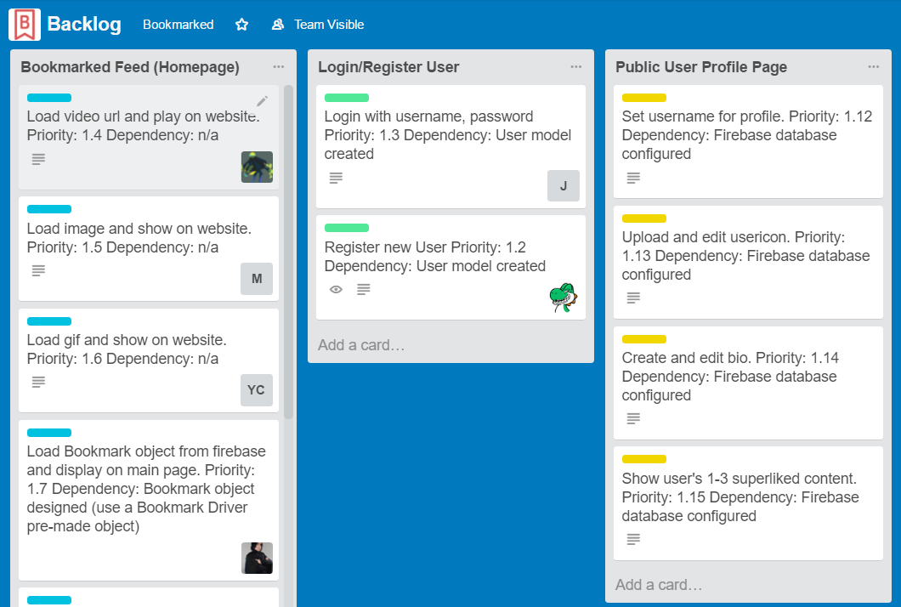
Product Backlog - Backlog Close-Up

Slide 4
Product Backlog - Example #1
As a visitor of Bookmarked, I want to be able to view the content posted by others, so I can explore new material.
Level 1 priority
No dependencies
Is a Minimum Marketable Feature (MMF)

Slide 5
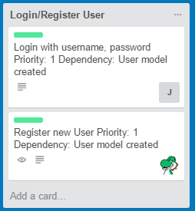
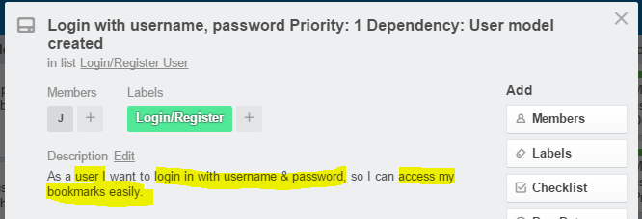
User Story Description

Slide 6
Priority
Must-Have
Necessary (but dependent on priority 1)
Nice-to-haves

Slide 7
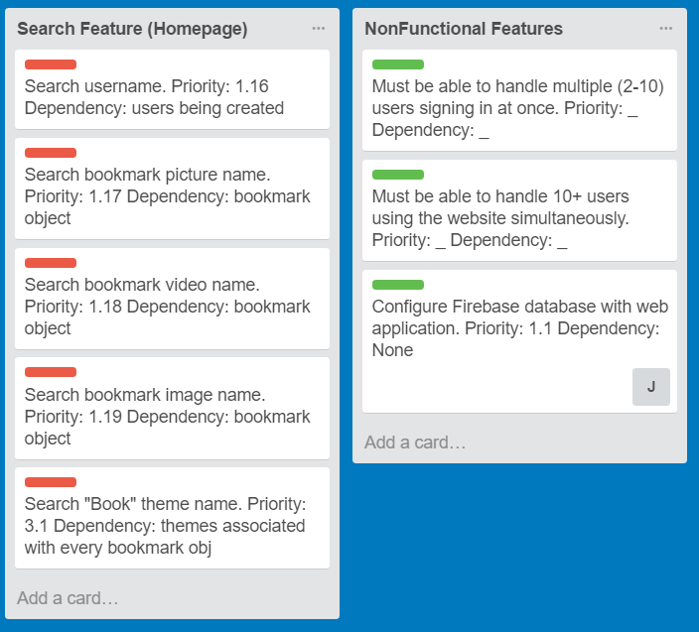
Functional vs. Non-functional

Slide 8
Dependencies
Design User Models
Populate User Models
Bookmark Objects

Slide 9
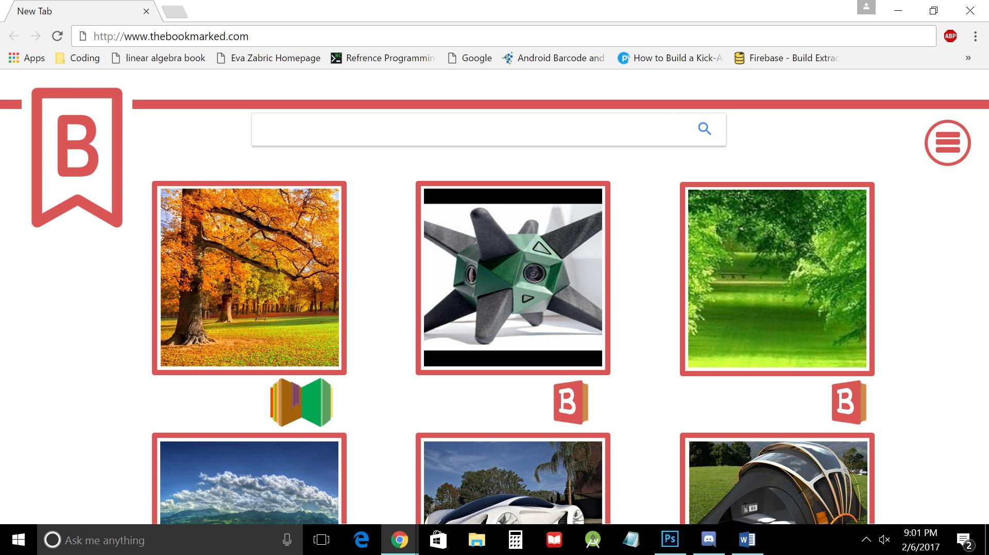
MMF (Minimum Marketable Feature)

Slide 10
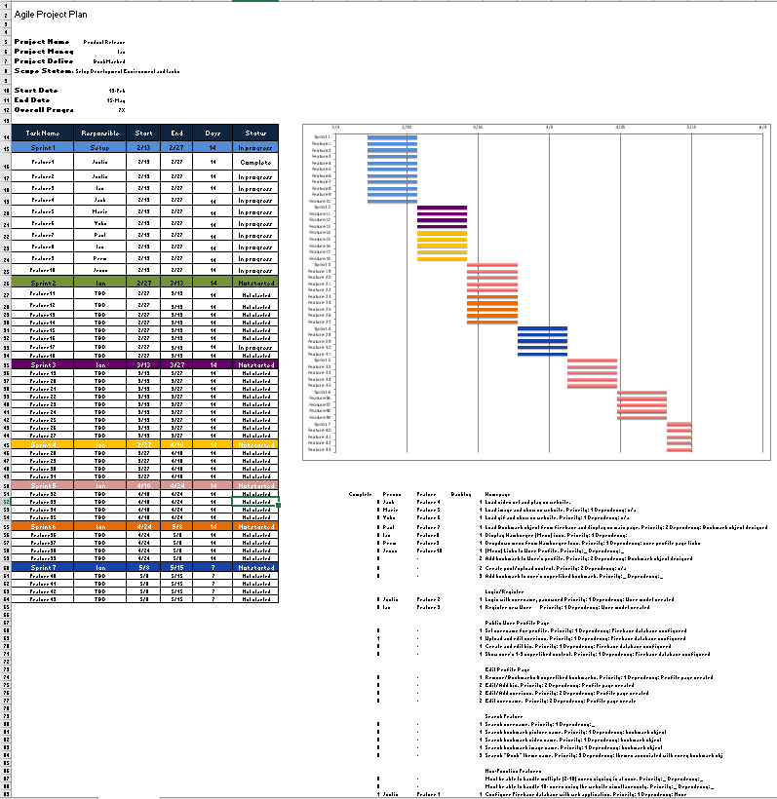
Sprint Planning Overview
Lets zoom in on next slide

Slide 11
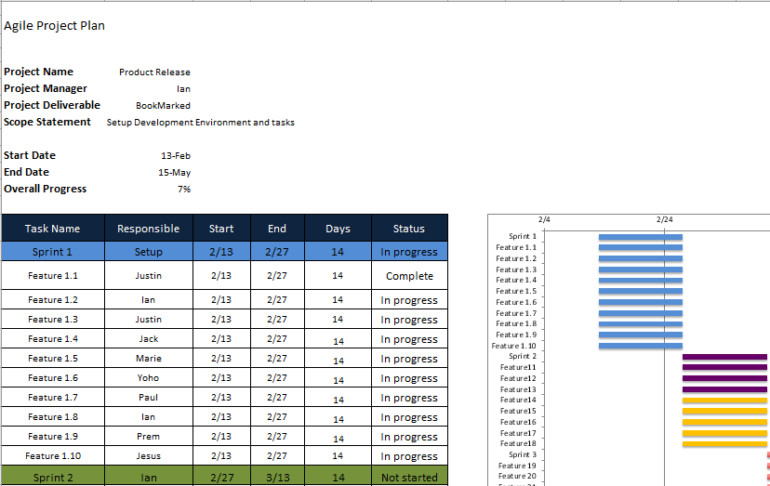
Sprint Planning Example - Sprint 1

Slide 12
Release Planning
Release #1 (Midterm Demo) : 3/20/17
Done with Sprint #3
Goal: Majority of Level 1 priorities met
Release #2 (Final Demo): 5/10/17
Done with Final Sprint #6
Finished Product, most features implemented

Slide 13
Questions?
Thanks!

